Slide 1
ANN
Basic Activation Functions

Slide 2
Basic Activation Functions
The activation function (also called a transfer function) shown in figure below can be a linear or nonlinear function. There are many different types of activation functions. Selection of one type over another depends on the particular problem that the neuron (or neural network) is to solve. The most common types of activation function are: -

Slide 3
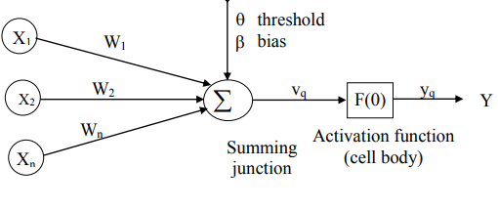
Nonlinear model of an ANN

Slide 4
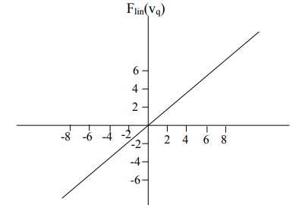
1- The first type is the linear (Ramp or identity) function.
Y_{q}=f_{lin(Vq)}=V_{q}

Slide 5
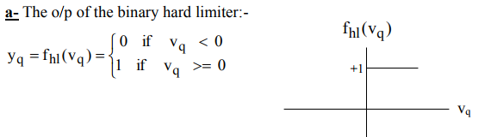
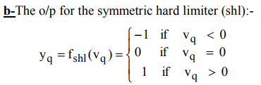
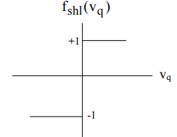
2-The second type of activation function is a hard limiter; this is a binary (or bipolar) function that either a 0 or a 1 for the binary type, and a -1 or 1 for the bipolar type. The binary hard limiter is sometimes called the threshold function, and the bipolar hard limiter is referred to as the symmetric hard limiter.

Slide 6


3-The third type is the saturating linear function or threshold logic Unit. This type of function can have either a binary or bipolar range for the saturation limits of the output. The bipolar saturating linear function will be referred to as the symmetric saturating linear function.
a- The o/p for the saturating linear function (binary o/p): -
b- The o/p for the symmetric saturating linear function: -

Slide 7
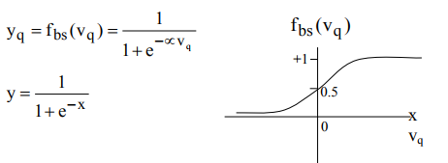
4-The fourth type is sigmoid. Modern NN's use the sigmoid nonlinearity which is also known as logistic, semi linear, or squashing function.

Slide 8
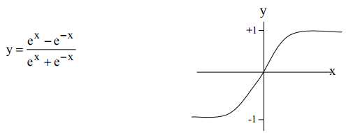
5- The fifth type is Hyperbolic tangent function is similar to sigmoid in shape but symmetric about the origin.

Slide 9
The Bias: Some networks employ a bias unit as part of every layer except the output layer. This unit has a constant activation value of 1 or -1, its weight might be adjusted during learning. The bias unit provides a constant term in the weighted sum which results in an improvement on the convergence properties of the network.
Ex.1 find O/P for the neuron if: - x1=0.5, x2=1, x3=0.7 w1=0, w2=-0.3, w3=0.6, using the five type of Activation functions?
Ex.2:- Find O/P for the neuron if x1 = 0.5, x2 = 1, x3 = -0.7 w1 = 0, w2 = -0.3, w3 = 0.6 θ = 1, using the five type of Activation functions?
Ex.3 Find O/P of a N.N using a sigmoid function, if learning rate is 0.5 when the input x1 = 1, x2 = 1.5, x3 = 2.5. and have initial weights value = 0.2?

